Slide 1

Client BPC
Statement of Work Kickoff
1
Our understanding
2
High-level project management plan
3
Resources and Pricing
4
Next steps and deadlines

Slide 2
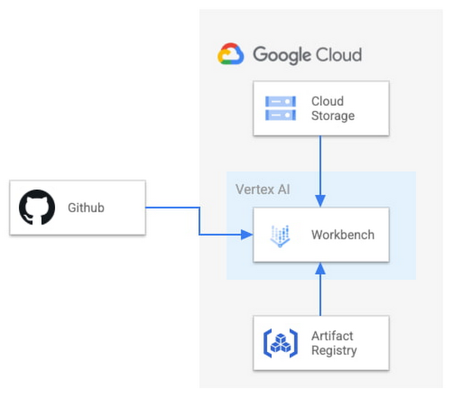
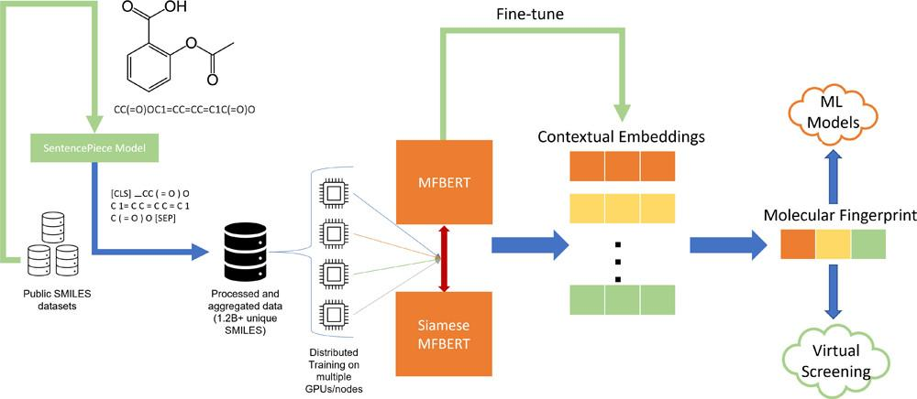
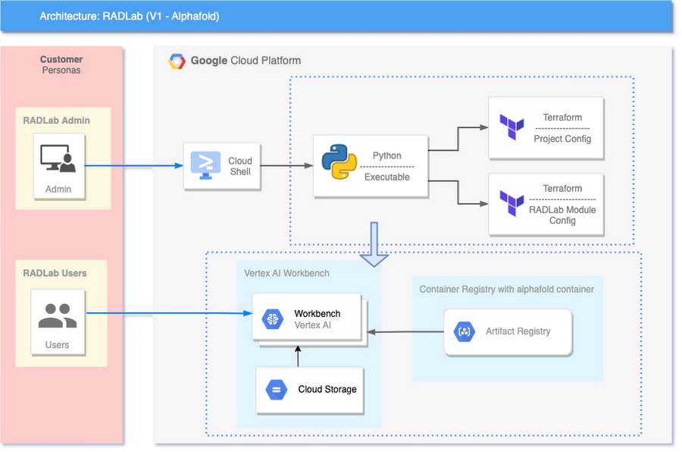
Current
Architecture
Proposed Architecture
Notes:
Successfully migrate (datasets), develop and deploy applications to support the experiment on Cloud for Dev, Test and Production Environments.
ML metrics - test accuracy, efficiency, training hours etc. as in consensus with the client.
Assumptions:
Client BPC will share the user accesses to the necessary systems with Deloitte.
Client BPC will provide necessary information needed to complete the scope of activities as defined in this document.
In case of any delays in the code due to dependencies on the client side will require project extensions with a re-evaluation on time.
Additional licensing costs will be borne by the client.
Client BPC will provide the transformation logic for any conformed data (like to HL7v2, 835 and 837 standards).

Slide 3
Project Management Plan
 | Week |  |  |  | Week |  |  |  | Week
 | 4 | 7 | 10 | 13 | 16 | 19 | 22 | 25 | 28 | 31 | 34 | 37-40
Scoping & Discovery
Discovery
Application architecture
Development
Infrastructure
ML model
DevOps/MLOps
Testing & Commit
System and integrations
ML
Implementation & Control
Production
Monitoring
Review & Closeout
Go Live and Validation
Estimated Timeline will be a total of 40 weeks from Scoping/Discovery to Go Live/Validate on Production.

Slide 4
Project cost
Role | Rate | Hours | Total (in US $)
Engineering Project Manager | $200 | 120 | 120*200 = 24,000
Cloud Engineer | $75 | 240 | 2 * 240*75 = 36,000
Solution Data Architect with HLS specialty | $250 | 120 | 120*250 = 30,000
Lead Principal Architect with Data/AI/ML Specialty | $300 | 120 | 120*300 = 36,000
Data Engineer | $150 | 480 | 3 * 480*150 = 216,000
Senior Data Scientist | $175 | 240 | 2 * 240*175 = 84,000
Total cost |  |  | $426,000
Sl. no | Component | Frequency | Rate (in US $)
1 | Project Cost: Resources - $426,000 Hardware, platform, etc. - $74,000 | One Time | $500,000
2 | Managing Services post production (if the client needs) | Monthly | $ as per Deloitte’s charge
3 | Services Funds from Cloud | One-Time | 10% of total cost

Slide 5
Roles and Responsibilities
Role | Project Needs (Quantity) | Responsibilities and Skill Sets
Engineering Project Manager | 1 | Sets up proper execution plan, Daily/weekly updates, Conduct kickoff meeting and weekly sync up calls, escalate issues and address concerns. Skills: Project management concepts, topics and tools.
Cloud Engineer | 2 | Setting up integrations, DevOps, CI/CD, creating technical documents and deployment runbooks, provisioning and configuring API endpoints to proxy applications. Skills: Operational efficiency, Building automation, CI/CD
Solution Data Architect with HLS specialty | 1 | Landing Discovery, design solution, data modeling and designing, end to end testing with UAT, execute data and ML pipelines. Advise on products for Healthcare and Life Sciences (HLS). Also communicate with Managers and Clients on data as needed. Skills: Documentation, Architecture design, HLS expertise.
Lead Principal Architect with Data/AI/ML Specialty | 1 | Supervising best practices of relevant Cloud Services, setting up testing end to end deployment, Cost optimizations, Validating the deployed architecture technically. Ensure HIPAA and local laws compliance to the projects. Also communicate with Managers and Clients on both short and long term success as needed. Skills: AI/ML advanced architectures, Cloud best practices
Data Engineer | 3 | Cleans data, Ingests data, Creation of data pipelines, data processing jobs, data validation scripts, ETL, Scheduling jobs and acting on monitoring/logging data. Skills: Python, Spark, Cloud Big Data, Messaging bus, ETL
Senior Data Scientist | 2 | Developing ML models for the chemical fingerprinting dataset, testing and improving the model, supporting the architects/engineers in deploying the model on Cloud. Skills: AI/ML concepts, Molecular Data concepts, ML model, Validation, Enhancements, Cloud machine learning

Slide 6
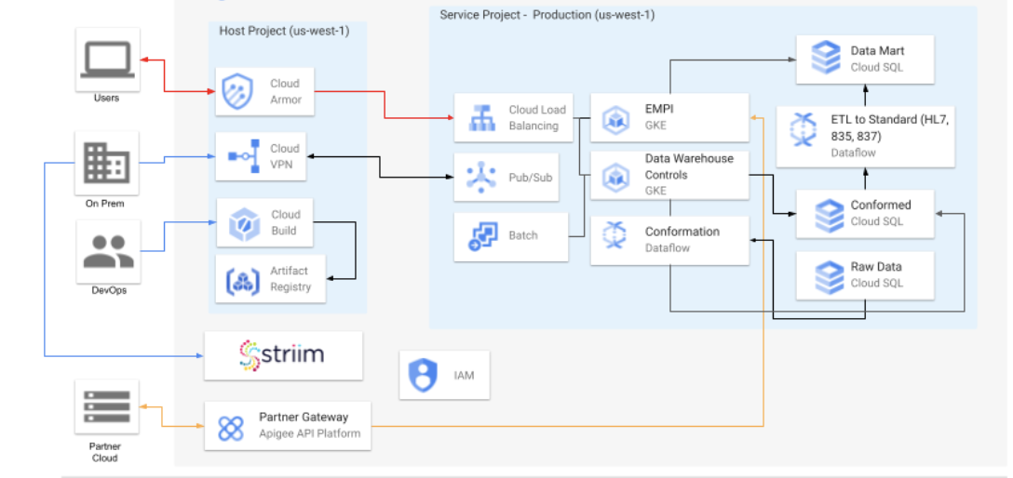
Expanded
Architecture

